Slide 1
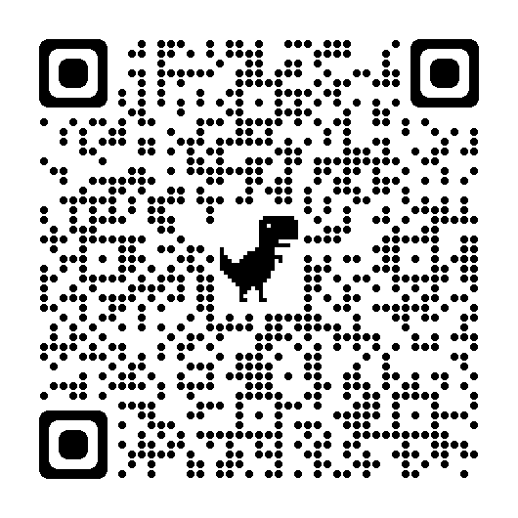
Files Download

Slide 2
DataBuds The Clusters
Madeleine & Gayatri
Objective: An outlook on clustering w hands-on
24 Nov 2022

Slide 3
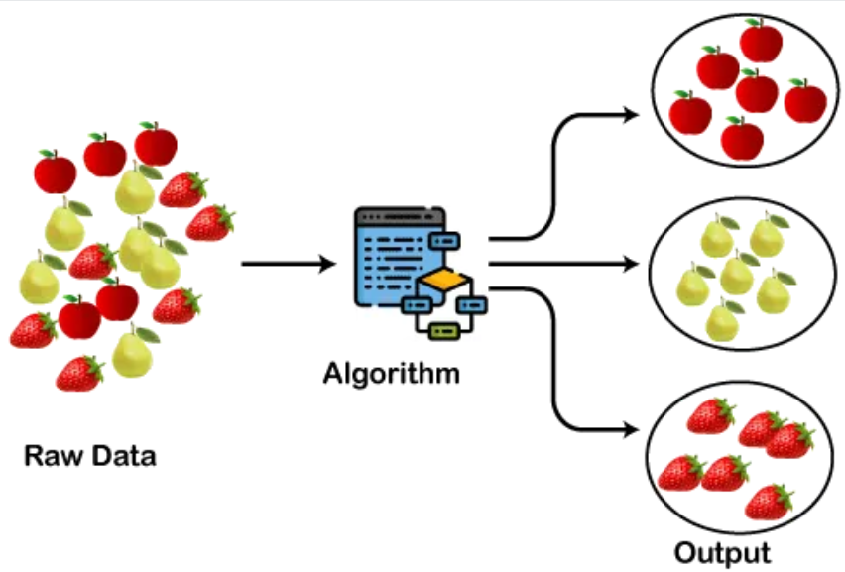
We know this….
What is Clustering?
Process of grouping objects in a manner that the objects in the same group are more similar to each other than to the objects in other groups
Image Source: https://static.javatpoint.com/tutorial/machine-learning/images/clustering-in-machine-learning.png
Regression
Supervised
Classification
Clustering
Unsupervised
Dimension Reduction
Self-Training
Semi-Supervised
Graph Based Algorithms
Machine Learning
Low Density Separation Models
Dynamic Programming
Reinforcement
Monte Carlo
Heurestics
RNN
Deep Learning
CNN
Image Source: https://www.researchgate.net/figure/Different-machine-learning-types-and-algorithms_fig6_330815113

Slide 4
Types of clustering algorithms
Agglomerative
Hierarchical
Divisive
K Means
Partitioning
K Medoid
Clustering
DBScan
Density Based
OPTICS
GMM
Distribution Based
SOMs

Slide 5

Hierarchical Clustering
The idea is that objects nearer to each other are more related.
Hence, we can break down the objects in a hierarchical manner using some criterion (e.g distance)
Agglomerative – Bottoms up
Divisive – Top Down
Notes:
Partitioning –
Kmeans - relatively efficient, but often local optimum. Cannt handle noise / outliers. Not so suitable for convex shapes
Use k-medoids – a central point
Hierarchical – does not scale well. O(n^2)

Slide 6
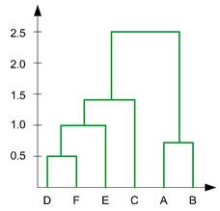
Question
At which distance should I define my merging to obtain 4 clusters?
0.1
0.9
1.3
2.0
(iv)
(iii)
(ii)
(i)
Notes:
Hierarchical clustering is often used in the form of descriptive modeling rather than predictive. It doesn’t work well on large datasets, it provides the best results in some cases only. Sometimes it’s also difficult to detect the correct number of clusters from a dendogram.

Slide 7
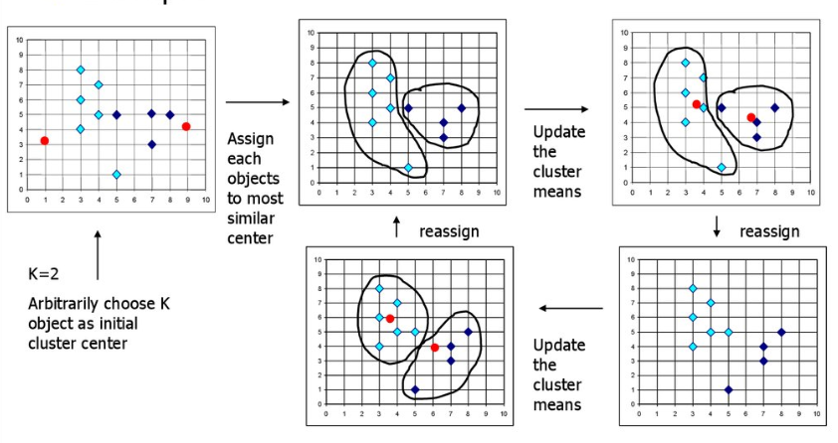
Partitioning Algorithms
The idea is to select N centroids and assign nearby objects to the nearest cluster centers.
One drawback is that we need to know how many centroids to start with.
Steps in KMeans clustering
Initialize centroids randomly based on the specified number of clusters (Red dots)
Calculate the distance between data points and each centroid, and assign the data points to the nearest centroids
Recalculate the mean of the centroid based on all the assigned data points, till convergence (i.e. no change in centroid mean)

Slide 8
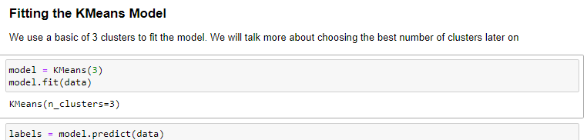
Running a KMeans Algorithm (An example – refer to hands on)
How can we evaluate the quality of this clustering?
Cannot calculate performance metrics like accuracy, AUC, RMSE, etc., to assess output of clustering
Good clustering has samples in each cluster bunched together, and not spread out (i.e. tight clusters)
Spread of samples within each cluster is measured by the "inertia" 🡪 Lower inertia value is better

Slide 9
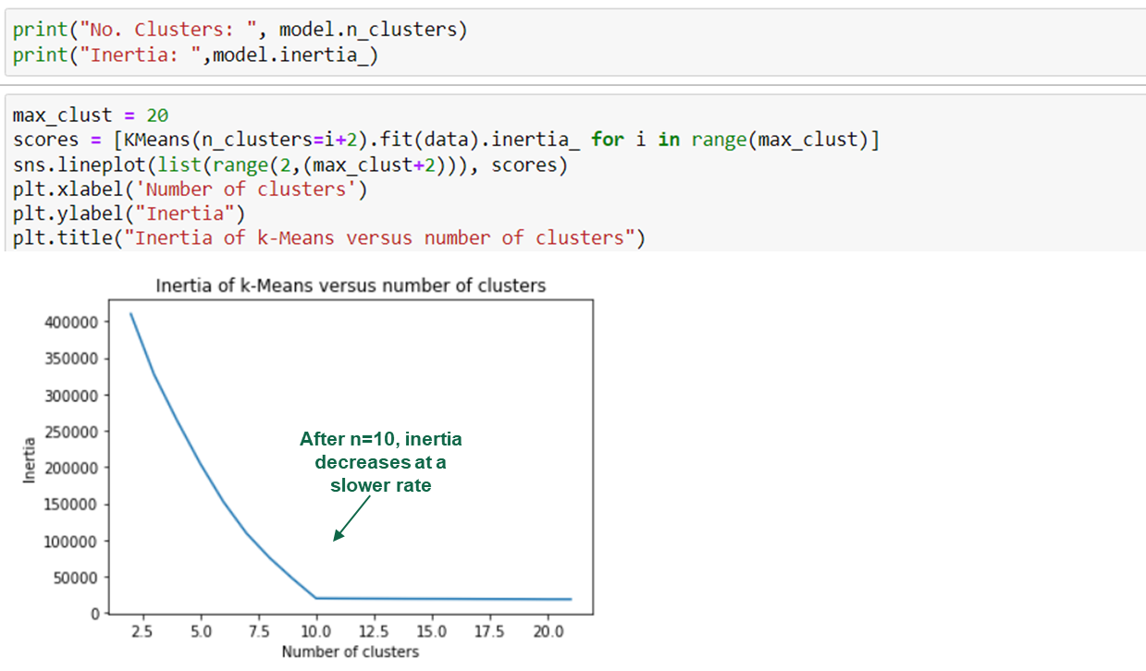
How to select the best no. Centroids
The inertia of a KMeans model is measured automatically when any of the fit methods are called, and is available afterwards as the inertia attribute.
Repeat the process for different n-values to determine the optimal number of clusters. Plot of the inertia values with different numbers of clusters. Inertia continues to decrease slowly as n-value increases. A good rule of thumb is to choose an “elbow" in the inertia plot.

Slide 10
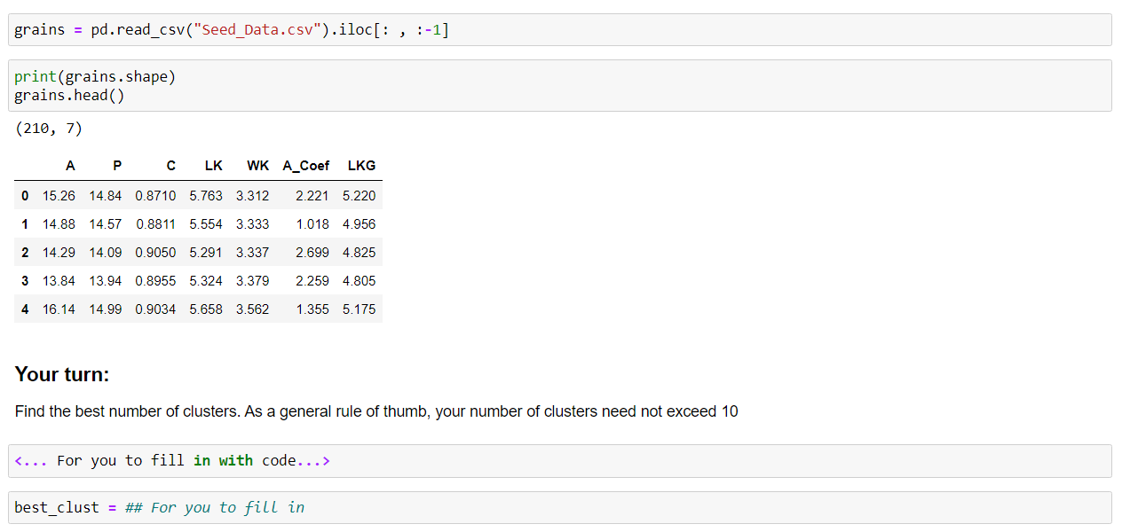
Challenge I – 10 mins

Slide 11

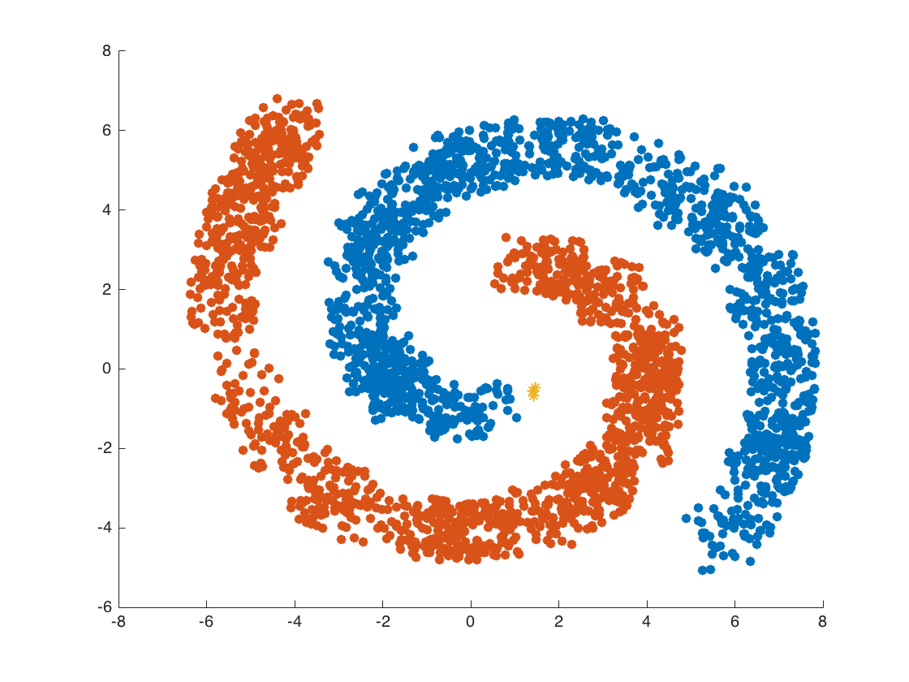
Density Clustering
Density Clustering assumes that objects in dense regions belong in the same cluster.
This allows for funny-shaped regions to be grouped in the same clusters

Slide 12
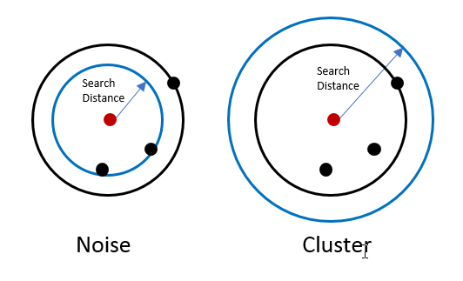
Density Clustering
DBScan - Density-based spatial clustering of applications with noise
Outliers will not effect creation of clusters
Notes:
http://pro.arcgis.com/en/pro-app/tool-reference/spatial-statistics/how-density-based-clustering-works.htm
Dbscan
OPTICS – variation of Dbscan but does not produce noise
Meanshift
It is commonly used for anomaly detection and clustering non-linear datasets.
On selecting epsilon -> https://towardsdatascience.com/machine-learning-clustering-dbscan-determine-the-optimal-value-for-epsilon-eps-python-example-3100091cfbc

Slide 13
Question
What is the weakness of the DBScan algorithm?

Slide 14
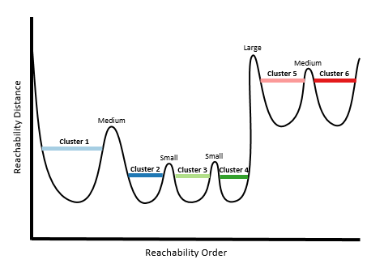
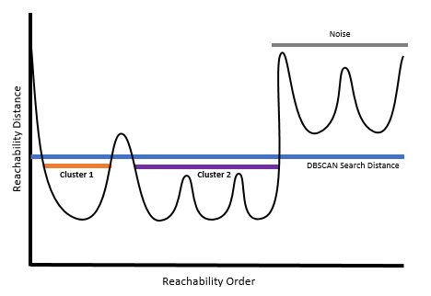
Density Clustering
DBScan
OPTICS –
Ordering Points To Identify the Clustering Structure
Notes:
How DBScan Works

Slide 15
Distribution-based Models
We assume the objects follow some distribution. We can then try to map the objects to a few distributions, and generate a probability score of which cluster the object belongs to.

Slide 16
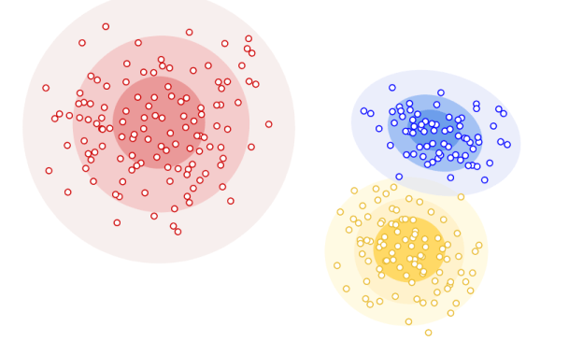
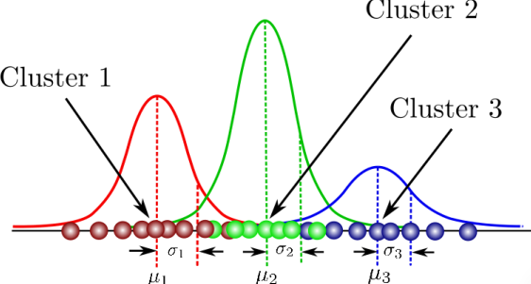
Distribution-based Models
Gaussian Mixture Model assumes N sets of Gaussian distributions in the dataset, and calculates the probability of each datapoint belonging to each distribution
Notes:
Mixture models are computationally expensive if the number of distributions is large or the dataset contains less observed data points.
It needs large datasets and it’s hard to estimate the number of clusters.

Slide 17
Let’s Discuss
When should we use GMM over other clustering methods?

Slide 18
Common uses of clustering
Image Compression
Creating customer profiles
Market research (e.g. Baskets of products)
Spam filters
Recommender systems
Anomaly detection

Slide 19
Summary of Algorithms Shared
Catogory | Pros | Cons
Hierarchical | Preserves hierarchy of variables; easy to explain Don’t need to pre-specify no. clusters | Not great with outlier handling
Partition | Fast, scalable to large datasets | Assumes speherical data shapes Sensitive to outliers. Need to specify # clusters Does not scale well (to no. features)
Density | Can handle odd-shaped data. Don’t need to define # clusters Can define cluster sensitivity. | Assumes consistent density. Need to set search distance Computationally intensive
Distribution | Can output probability for our analysis Can handle clusters overlapping | Computationally expensive Need large dataset to model distribution

Slide 20
Hands On Time – 30 mins
Refer to Bank Clustering Notebook
Task: Complete the notebook and fill in this quiz: <Insert link>
Fastest winners will win a token at the next DataBuds

Slide 21
References
http://www.cs.upc.edu/~bejar/apren/docum/trans/08-clustering-eng.pdf
https://en.wikipedia.org/wiki/Hierarchical_clustering
https://uc-r.github.io/hc_clustering
http://pro.arcgis.com/en/pro-app/tool-reference/spatial-statistics/how-density-based-clustering-works.htm
https://ppt-online.org/25080
https://neptune.ai/blog/clustering-algorithms

Slide 22
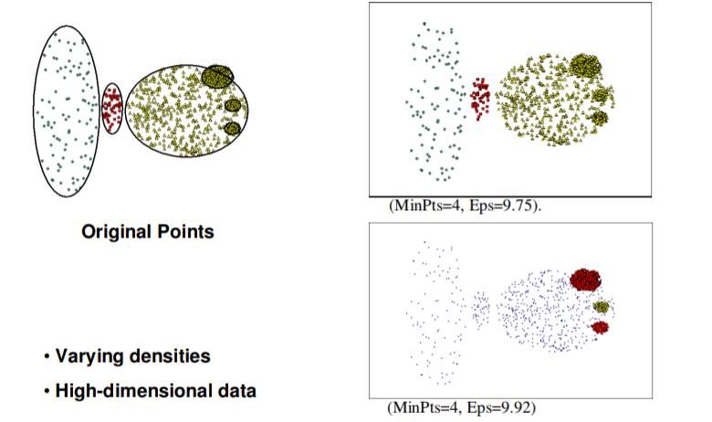
DBScan assumes consistent density

Slide 23
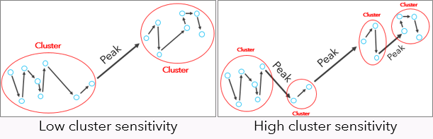
Another Density Cluster - OPTICS

